Slide 2
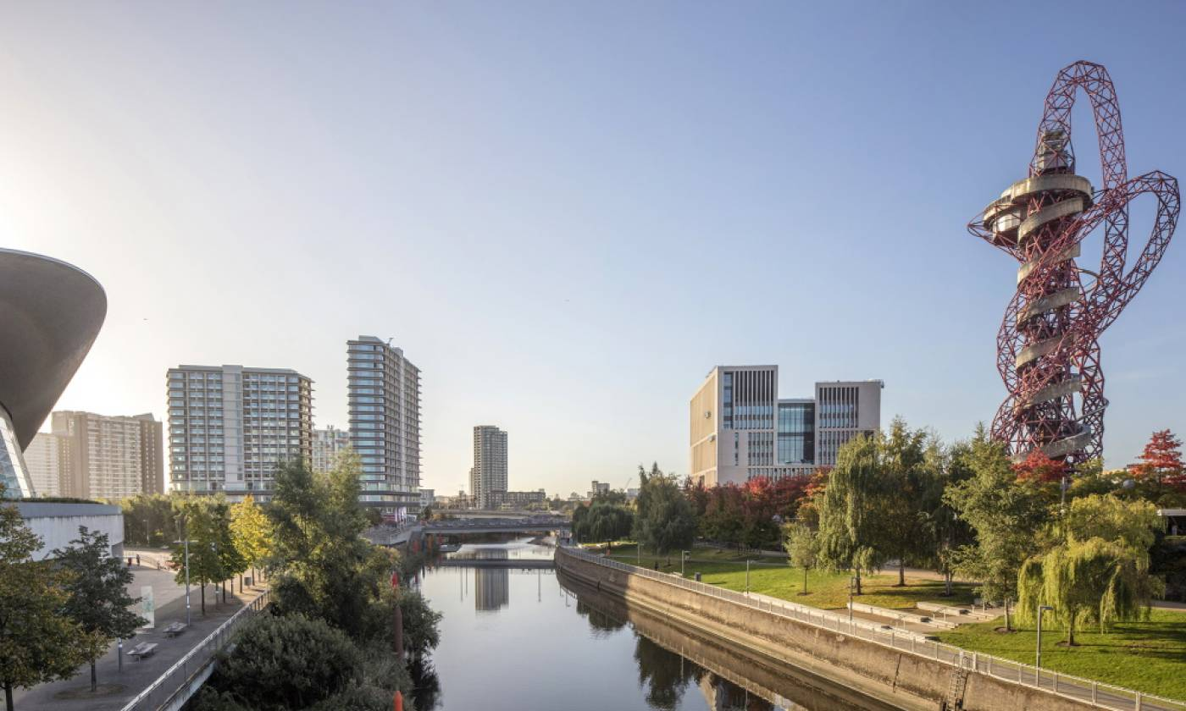
UCL East | UCL East - UCL – University College London
Notes:
This month, finally marsh gate building is completed and waiting for the student of the next year.

Slide 3
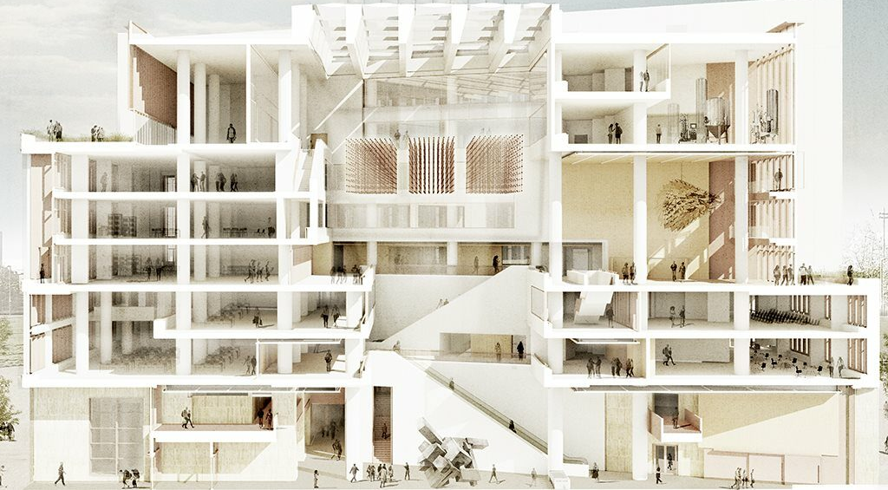
Mace wins £200m UCL Olympic Park campus deal | Construction News
Notes:
This is a cross section of Marsh gate and it is huge and a complex building.

Slide 4
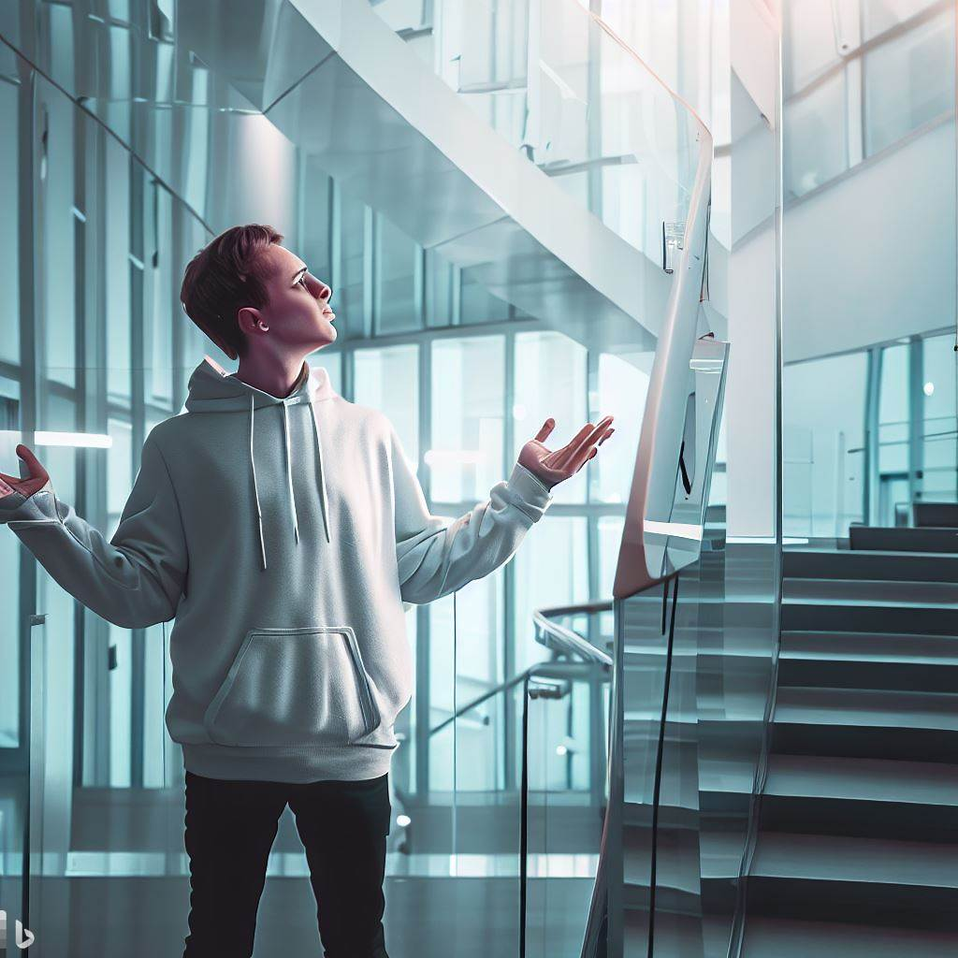
Bing Image Creator
Notes:
Let’s think you are a new student or staff. How can you find a place you want to go?
It would be very difficult and take some time.

Slide 5
AI Powered
Indoor Locator
No GPS
Many Walls, Floors
Notes:
To help them, I started this project.
Unlike outdoor, finding a user’s location is really hard. Because GPS signal is limited due to the structures. And this walls and floors are blocking user’s sight.

Slide 6
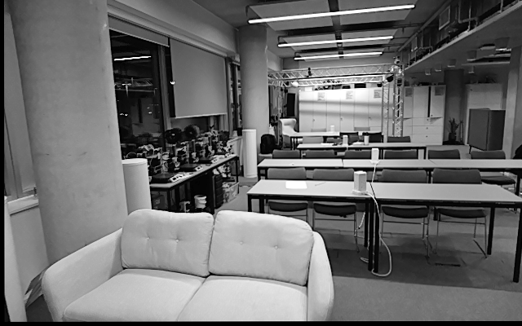
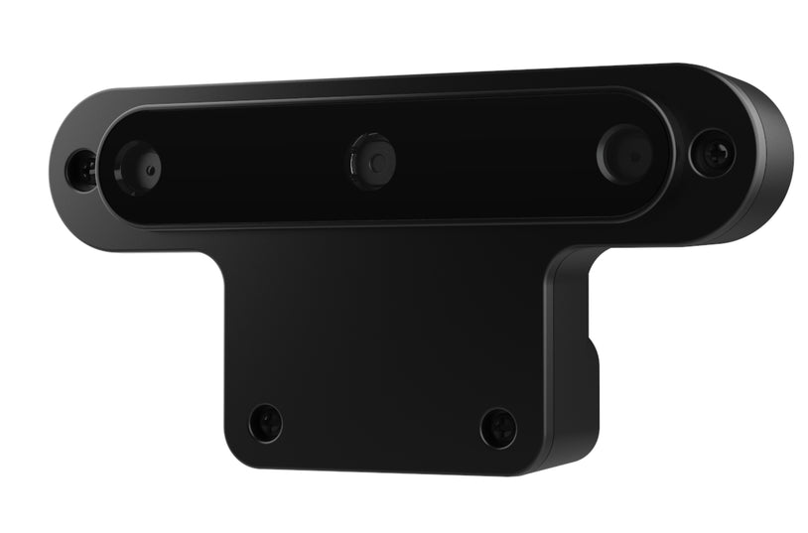
AI Powered
Indoor Locator
You are in front of the red telephone box in CE Lab!
Notes:
So my project goal is finding user’s location using a camera.

Slide 7
Oak-D!
I am not just a camera.
I can run AI model.
Notes:
This camera is not just a camera. This has three lens and its own cpu to run AI model.

Slide 8
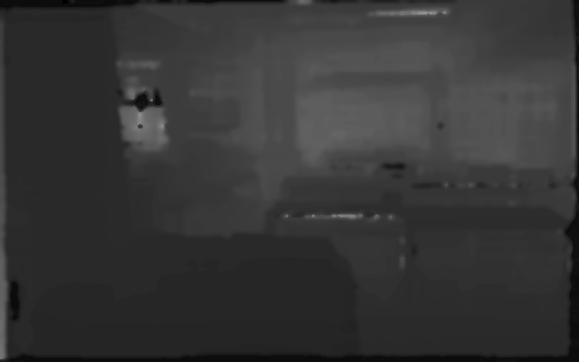
Let’s see…
Aha!
Notes:
Why does it have lens camera? Because this camera can measure depth from the camera by combining images.

Slide 9
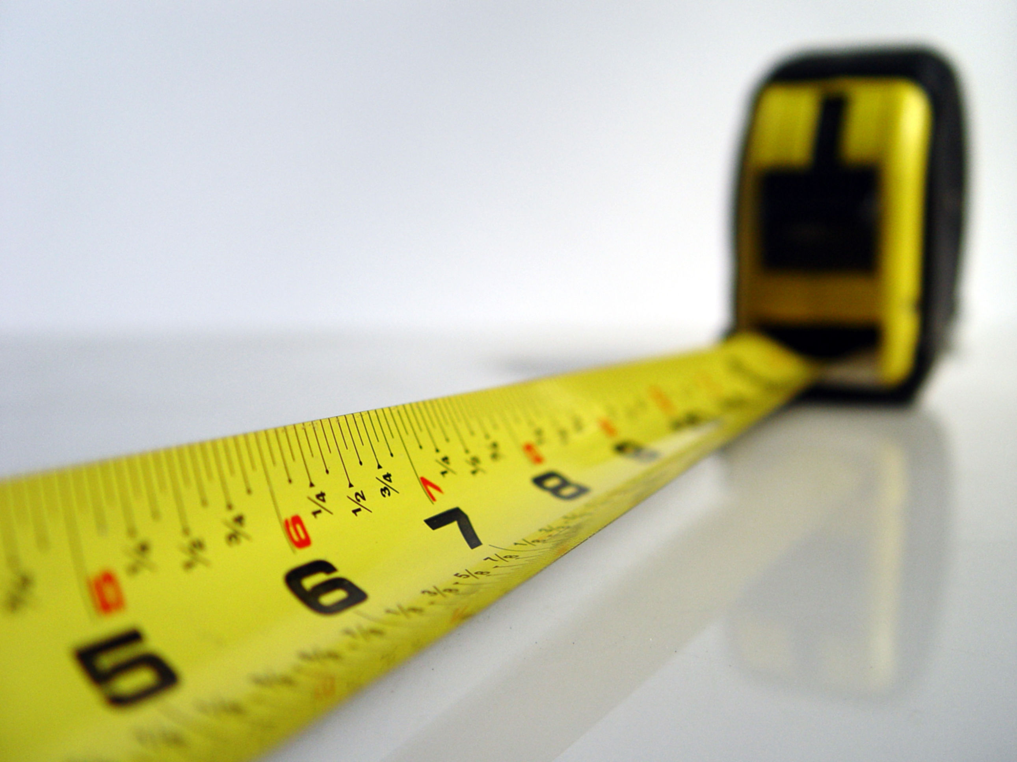
Measurable
Make It Measurable (learningapprentice.com)
Notes:
Thus, we can get a image which can be measured. It would be helpful to train an ai model.

Slide 10
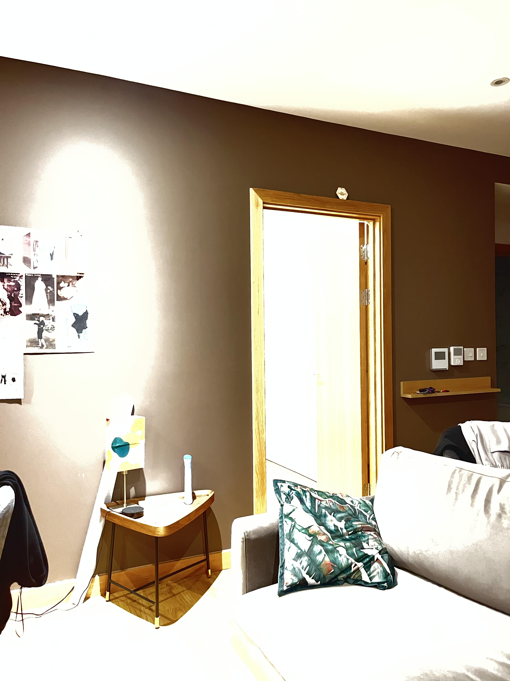
Light Condition
Notes:
Also, AI can see the scene even if light condition is too dynamic!

Slide 11
I see!
AI
Notes:
Now we found what to use for our AI model. Then how to train the AI?

Slide 12
Collecting Data
Processing Data
Training AI
Notes:
Actually training is one of a part of whole process. There is Processing! And Collecting process are waiting.

Slide 13
Collecting Data
Q
A
Depth Image
Orientation
Acceleration
Position
Notes:
Collecting data is most important part in the process. If there is not enough data, Our AI can’t study very well. And if we give wrong data, the AI would answer wrong data.
In the project, I picked three inputs and 1 output. I am going to use Depth image, orientation ,acceleration. And I will show the AI the position when the input is recorded.
Okay what is orientation and acceleration and how to get position?

Slide 14
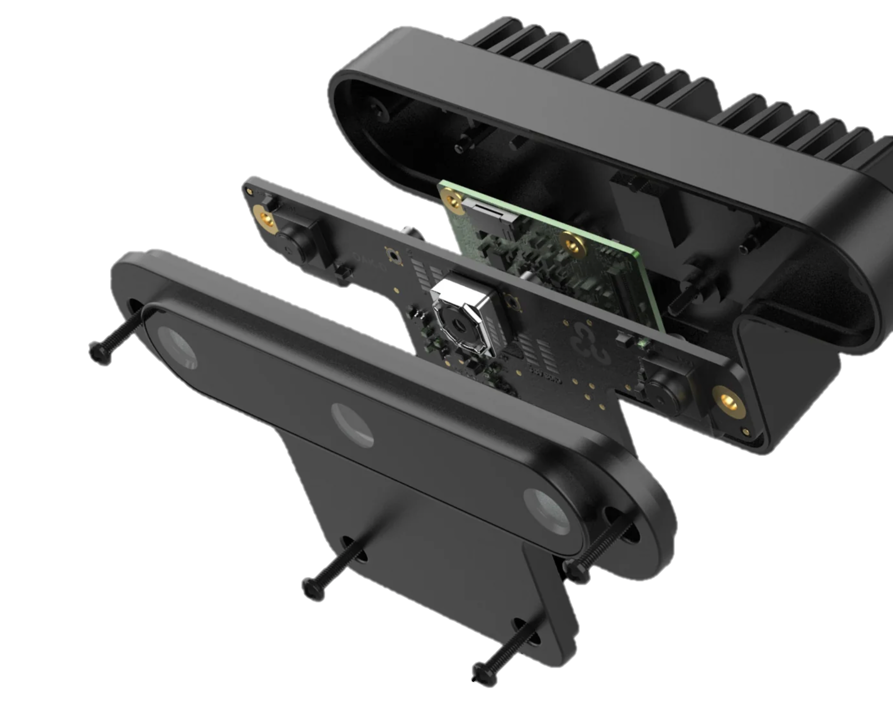
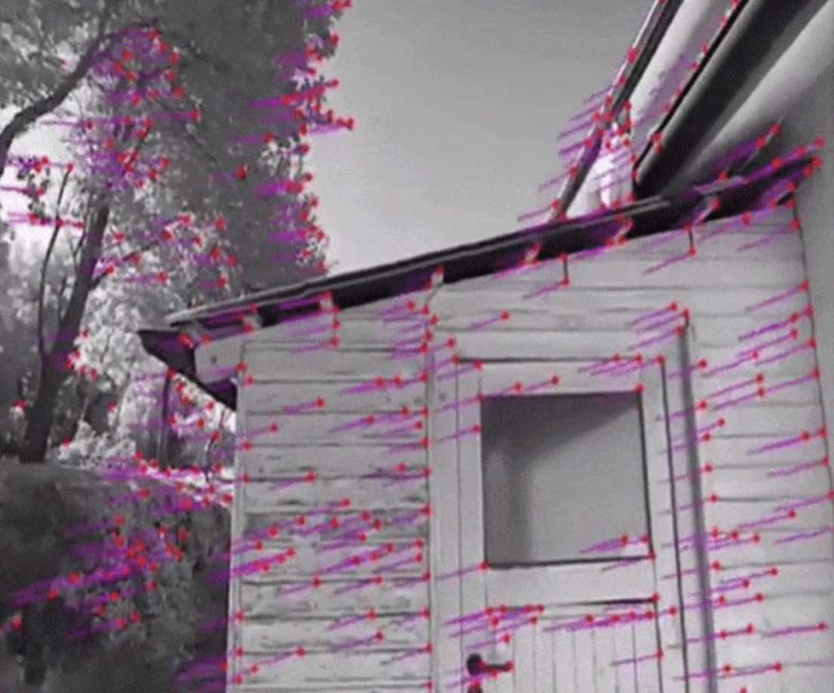
Collecting Data
Inertial measurement unit (IMU)
9-axis sensor,
combining
accelerometer, gyroscope, and magnetometer
Orientation
Acceleration
Depth
Feature Detection
Position
Notes:
Our camera is really smart. It has IMU sensor
And it gives Orientation and Acceleration.
Then how to get a current position.
Camera support feature detection. It detect some features in a scene and track its locations real-time.
By combining those information, we can get relative position. And we can convert this relative position into world position if we know the place and Where did I started.

Slide 15
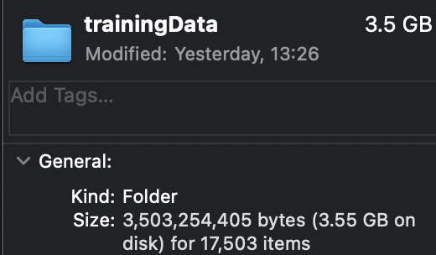
Collecting Data
Notes:
So I collected 5 training set in CE Lab and each set has around 3000 images.

Slide 16
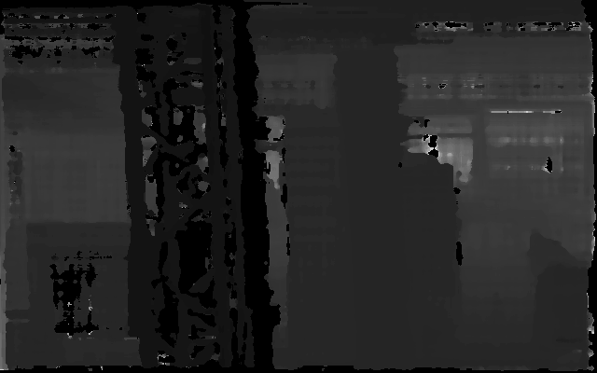
Processing Data
Notes:
Okay. Now we collected data. But let’s see one sample. As you can see the image is not good and too many noise. To improve the result, noise should be filtered.

Slide 17
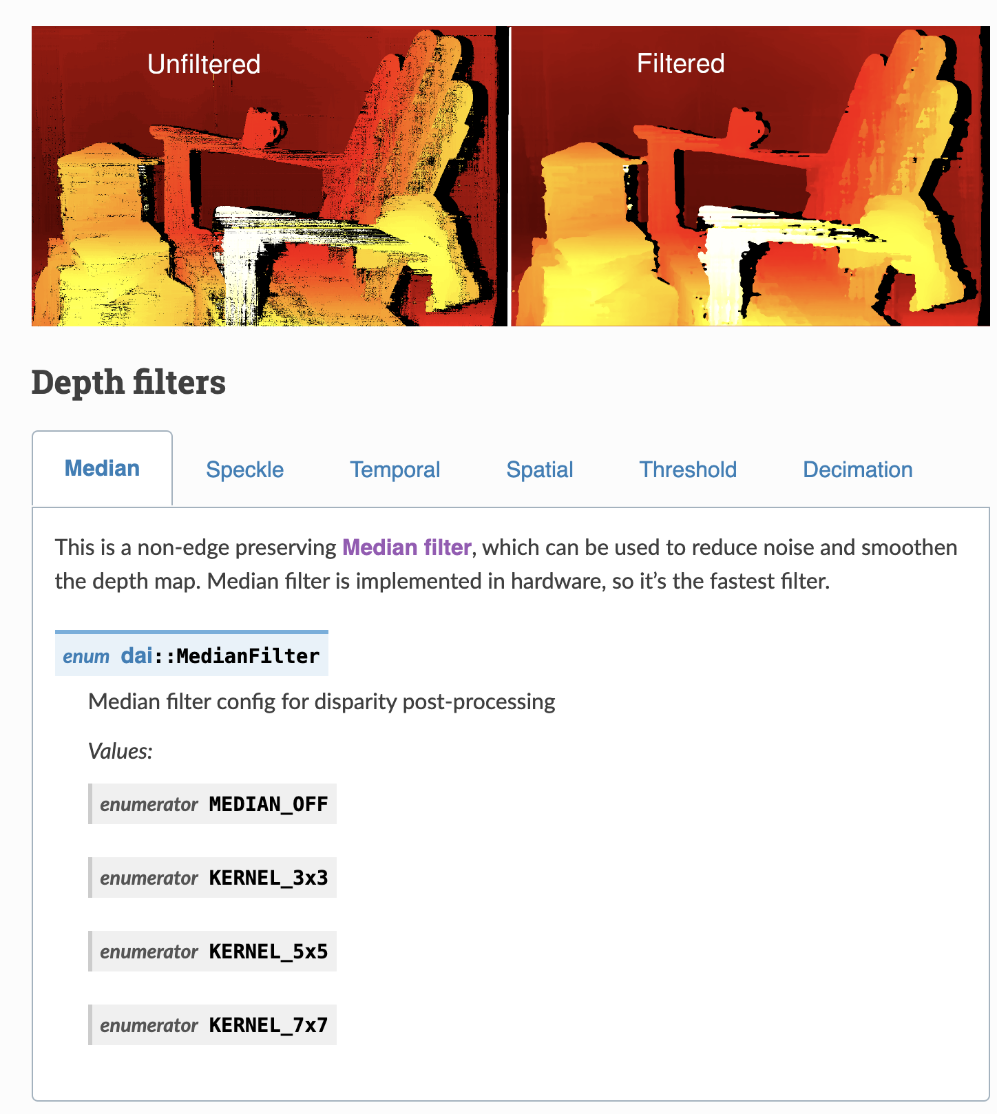
Processing Data
Notes:
Thanksfully, Oak-d camera support some depth filters and I used median and Speckle filters.

Slide 18

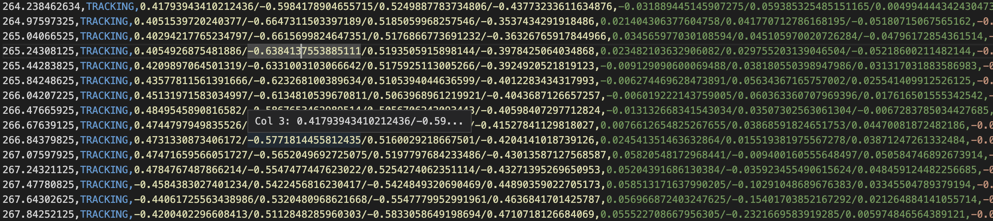
Processing Data
Images
Matching
IMU Record
Notes:
Also IMU record is needed to matched with images by checking recorded time –stamp.

Slide 19
Training AI
Depth
Others
Dense
Input
Input
2D convolution
Dense Layer
Output
Position
(XYZ)
Notes:
Okay. Now finally it time to train the AI model. This is initial AI model structure. Depth images are going to CNN layers and other data from IMU goes to Dense layers
And the results combines and xyz position will be generated as output.

Slide 20
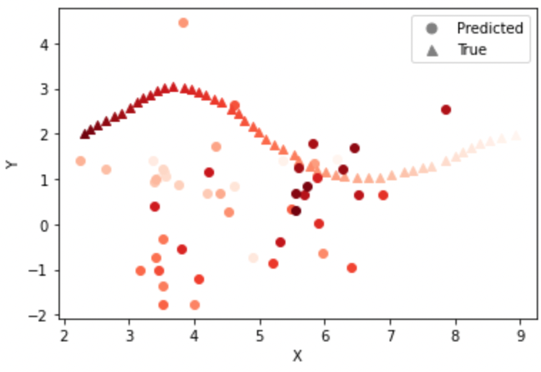
Training AI
Notes:
But… this is the result. As you can see. The AI model is not predicting at all.
And I found it is really hard to find XYZ coordinates since dataset is too small.

Slide 21
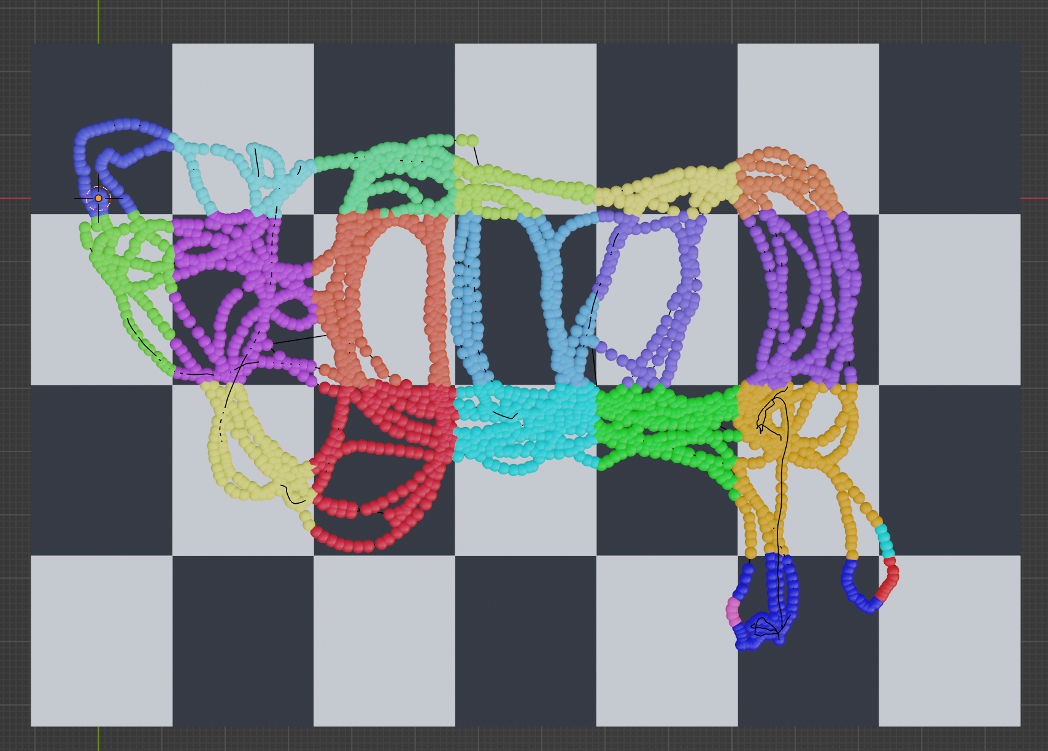
Processing Data
1
2
3
Telephone Box
28
Workstation
CE Entrance
Notes:
So I decided to use grid zone instead of XYZ coordinates. I set the zone size to be 2m by 2m. And visualize my data to compare with result.

Slide 22
Processing Data
Q
A
Depth Image
Orientation
Acceleration
Position
Grid Zone
Notes:
So in the final model the AI will predict Grid Zone instead of position.

Slide 23
Training AI
Depth
Others
Dense
Input
Input
2D convolution
Dense Layer
Output
Position
(Grid)
Notes:
But except output, other layers will be the same.

Slide 24
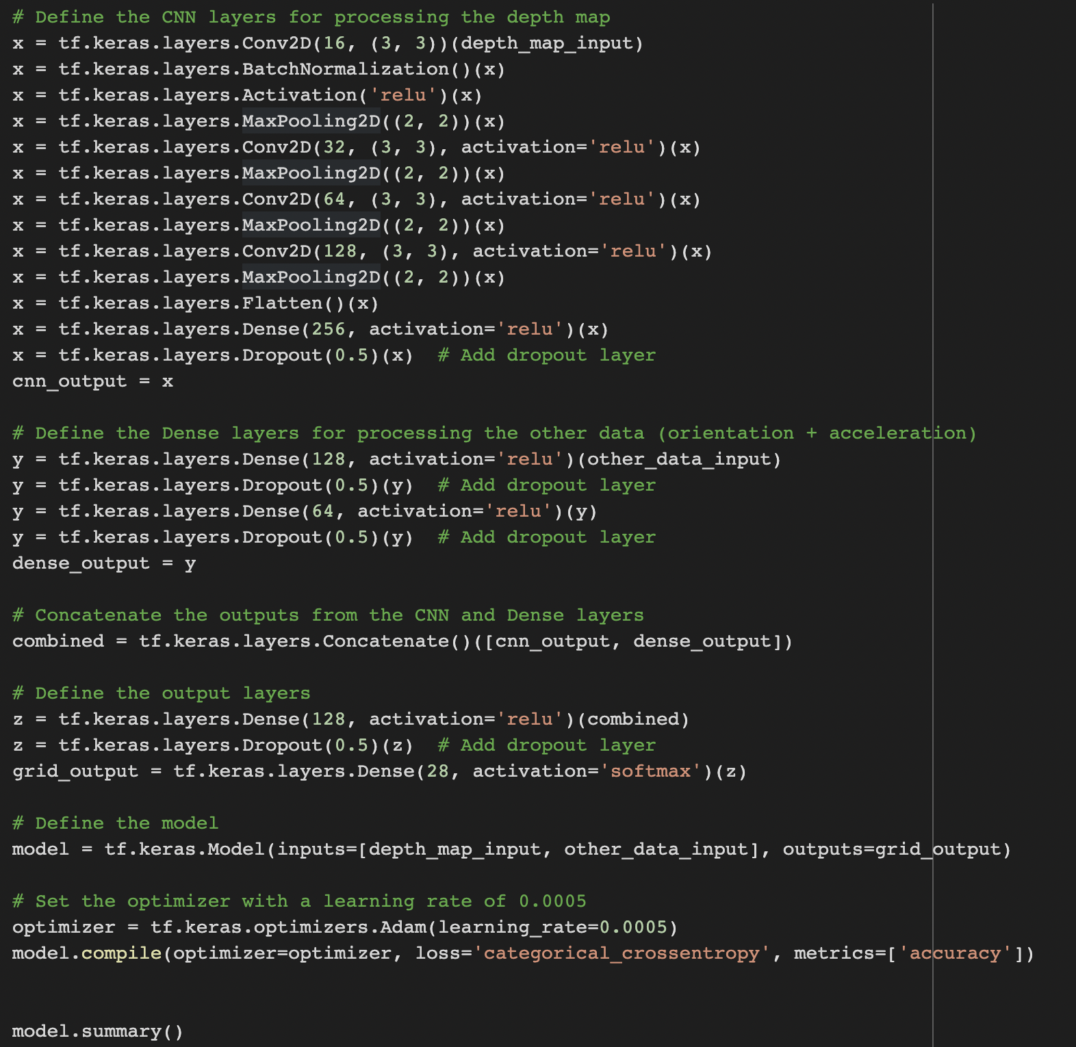
CNN for Depth
Dense Layers for IMU data
Combined Layer
Output Layer
Notes:
This is detail of the AI model. First, Depth information is process in CNN layers and other IMU data will be processed in Dense Layers.

Slide 25
Dropout Layers to prevent the overfitting
Notes:
Also, to prevent the overfitting, I used dropout layer. The Dropout layer randomly sets input units to 0 with a frequency of rate at each step during training time

Slide 26
Training AI
Input | Output | Model | Window Size | Learning Rate | epochs | batch size | Loss Function | Loss | Validation Loss | Accuracy | Validation Accuracy | Remark
Depth, IMU, Previous Coordinates | Current Coordinate | Non-Time Series | N/A | 0.001 | 100 | 16 | mse | 0.2327 | 0.3322 |  |  | Model is heavy depending on Previous Coordinate
Depth | Current Coordinate | CNN | N/A | 0.001 | 50 | 32 | mse | 4.58 | 9.3604
Depth, IMU | Current Coordinate | Non-Time Series | N/A | 0.001 | 50 | 32 | mse | 0.6974 | 7.5666
Depth, IMU | Current Coordinate | Non-Time Series | N/A | 0.001 | 100 | 64 | mse | 0.0169 | 4.4962
Depth, IMU, Previous Coordinates | Current Coordinate | Non-Time Series | N/A | 0.001 | 100 | 16 | mse | 0.0012 | 0.1068 |  |  | Model is heavy depending on Previous Coordinate
Depth, IMU, Previous Coordinates | Current Coordinate | Non-Time Series | N/A | 0.001 | 100 | 8 | mse | 0.00041575 | 0.0272 |  |  | Model is heavy depending on Previous Coordinate
Depth, IMU | Current Coordinate | Time-Series | 5 | 0.001 | 100 | 32 | mse | 2.2811 | 54.1758
Depth, IMU | Current Coordinate | Time-Series | 5 | 0.001 | 100 | 16 | mse | 2.0411 | 54.1509
Depth, IMU | Current Coordinate | Time-Series | 20 | 0.001 | 100 | 16 | mse | 7.5802 | 72.4562
Depth, IMU | Current Coordinate | Time-Series(Overfitting) | 20 | 0.01 | 100 | 16 | mse | 16.6554 | 74.6363
Depth, IMU | Current Coordinate | Time-Series(Overfitting) | 2 | 0.01 | 100 | 16 | mse | 11.5243 | 45.2927
Depth, IMU | Current Coordinate | Non-Time Series | N/A | 0.01 | 50 | 16 | mse | 11.7886 | 31.9624
Depth, IMU | Grid | Non-Time Series | N/A | 0.0005 | 50 | 50 | categorical_crossentropy | 0.242 | 2.519 | 0.9229 | 0.4077
Depth, IMU | Grid | Non-Time Series | N/A | 0.0005 | 50 | 70 | categorical_crossentropy | 0.155 | 2.1651 | 0.9519 | 0.4876 - 0.56
Depth, IMU | Grid | Non-Time Series | N/A | 0.0005 | 50 | 5 | categorical_crossentropy | 0.0802 | 3.4069 | 0.9781 | 0.44

Slide 27
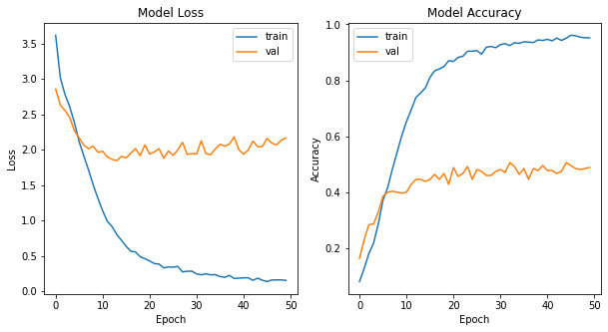
Training AI
Notes:
I changed many variables but could not get the good result. But after many attamps, instead of just checking loss and accuracy. I decided to plot the point with grid.

Slide 28
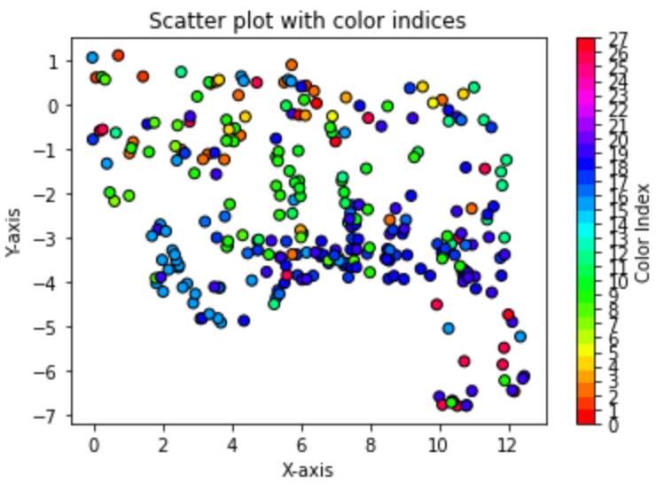
Training AI
Notes:
And surprisingly the ai was not totally wrong but The AI model was finding approximately close values.
And I found the fundamental problem is number of data source. because it has a good prediction rate for grids with a lot of data.

Slide 29
Lesson Learnt & Limitation
Too dynamic Target environment
Limitation of the depth camera and IMU
Data collection and processing time
Limited resources
Notes:
I learnt a lot from this project and found that there were a lot of constraints. Firstly, I was unable to find a suitable experimental environment, so I targeted the CE lab and collected data over several days. However, many objects in the lab were frequently relocated, which limited the data available. Secondly, there was a lot of noise in the relative coordinates obtained by OAK-D. This had an adverse effect on the training. Thirdly, it took a lot of time to set up the depth camera and collect and process data using it. We learnt a lot in the process, but it was not possible to complete everything in a short project period. Finally, training the AI consumed a lot of resources. The resources provided by google colab were insufficient, so we subscribed to additional resources, but it was not a fundamental solution.

